Slide 1
Concurrency
and
multithreading

Slide 2
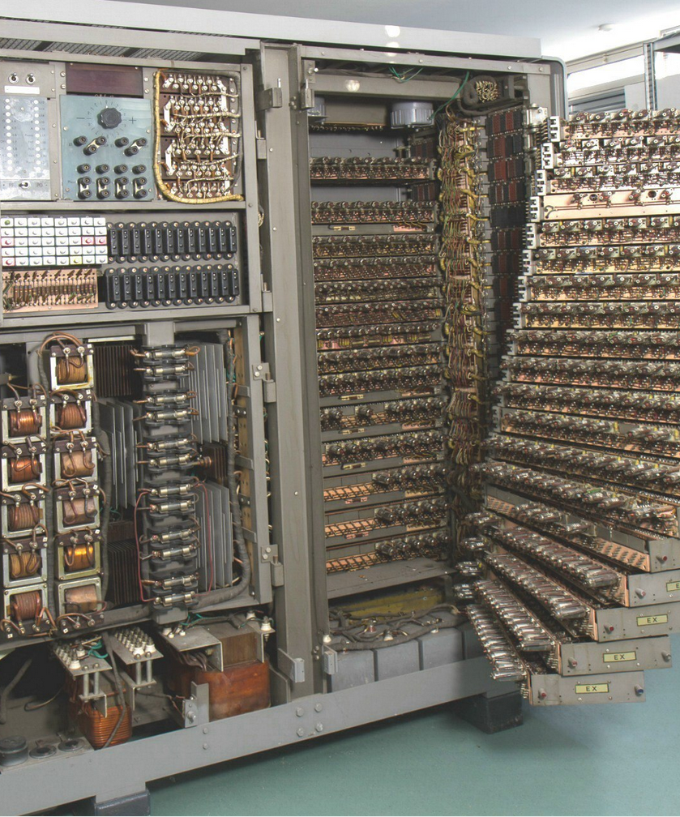
When computers were VERY big...

Slide 3
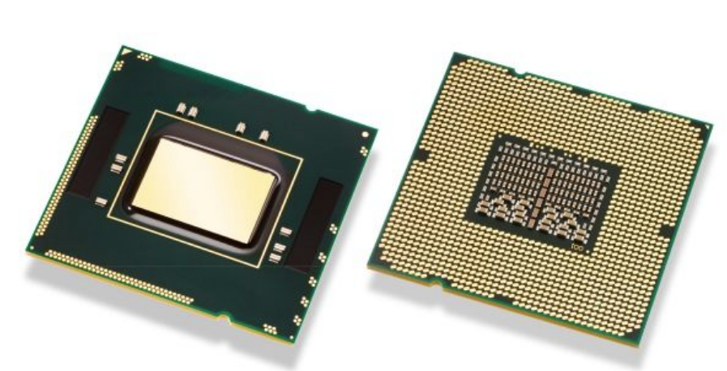
Modern CPU

Slide 4
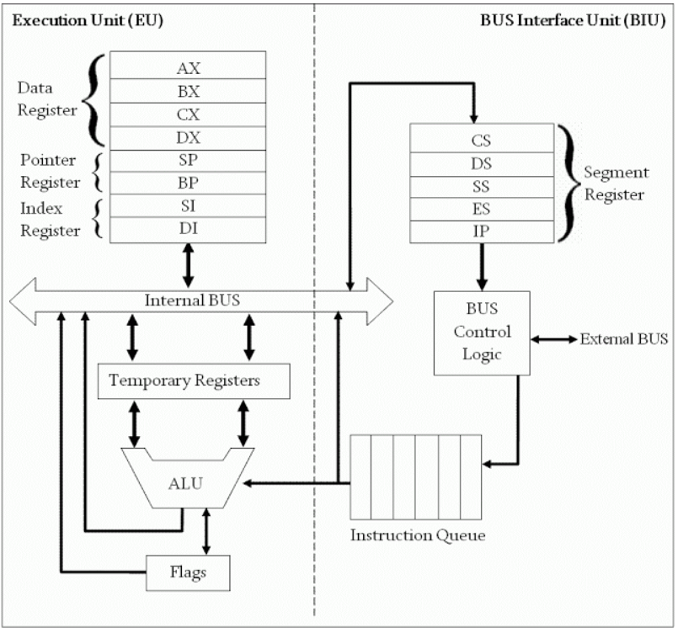
Very very simplified 8086 CPU structure

Slide 5
Process - is currently executing program and
and all program`s elements: address space, global variables, registers, stack, opened files and so on.
Thread - execution is the smallest sequence of programmed instructions that can be managed independently by a scheduler, which is typically a part of the operating system. The implementation of threads and processes differs between operating systems, but in most cases a thread is a component of a process. Multiple threads can exist within one process, executing concurrently and sharing resources such as memory, while different processes do not share these resources.
Locks - mechanism that allows to keep shared objects in consistent state.

Slide 6
Thread safety - property of multitask system to get access to shared objects and maintenance shared objects in consistent state.
Shared objects - objects to which can access multiple threads.
Atomicity or atomic operations - operation which can be executed entirely or doesn`t executed at all.

Slide 7
End of first lection

